Slide 1
Boosting Retention through Predictive Modeling
Yuejia (Mandy) Teng, PhD

Slide 2
Executive Summary
Assumptions and Data Overview
Data at a Glance
Data-Driven Approach to Predicting Turnover
Data Exploration and Initial Insights
Key Insights on Reducing Employee Turnover
Impact and Actionable Recommendations
Measuring Impact and Next Steps
Agenda

Slide 3




Executive Summary
Purpose
Analysis and Findings
Recommendations
Next Steps
Leverage predictive analytics to identify at-risk employees.
Develop retention strategies to reduce turnover rates.
Propose methods and metrics to evaluate the effectiveness.
A Random Forest model selected to predict turnover and identified key drivers.
Employees with lower belonging and engagement, limited growth, low recognition have higher risk.
Specific groups (e.g., onsite) have higher turnover.
Approximately 10% of employees at high risk.
Take actions to improve employee experience such as belonging, engagement, growth, recognition.
Pinpoint at-risk employees and subgroups to prioritize retention efforts.
Evaluate the progress in real time and post-doc, and communicate to stakeholders and employees frequently.
Balance quick wins vs. long term bets in retention strategies to achieve sustained results.
Evaluate the effectiveness of strategy adoption using workforce, customer, and business outcomes.
Maintain and refine the predictive model to identify at-risk employees in real-time.

Slide 4
Assumptions and Data Overview
Objective
Leverage predictive modeling to identify turnover risk factors and propose data-driven retention recommendations.
Propose methods to measure and evaluate retention strategies over time.
Assumptions
A mid-sized multinational company with a turnover rate higher than the industry benchmark.
Employee turnover and survey data representative of the entire organization.
Longitudinal data collected at 2 timepoints with no missing values.
Stable economic conditions, with no major industry shifts during the analysis period.
Data Sources
5000 data points from engagement surveys, performance management systems, HRIS.
Incorporated external benchmarks from industry reports to contextualize findings.

Slide 5



Data at a Glance
Experience Surveys
Demographics
Other HRIS Data
Job Satisfaction
Engagement
Belonging
Recognition
Growth Opportunity
Work Life Balance
Psychological Safety
Culture
Satisfaction with Supervisor
Tenure (years)
Job Level*
Department*
Team Size
Race / Ethnicity*
Region*
Work Arrangement (onsite vs. hybrid vs. remote)*
Performance Rating
Work hours per Week
Compensation
Months since Promotion
* indicates categorical variables; the rest are numeric.

Slide 6



Data-Driven Approach to Predicting Turnover
Data Cleaning and Exploration
Data cleaning included handling missing values, encoding for categorical variables, and scaling numeric variables.
Exploratory data analysis (e.g., descriptives, pearson and biserial correlations, crosstabs) conducted to form initial hypotheses.
Predictive Modeling
4 ML models (Logistic regression, Decision Trees, Random Forest, xgBoost) with 10-fold cross validation used and compared to predict turnover.
SMOTE (Synthetic Minority Oversampling) used to reduce the negative impact of imbalance data (20% turnover rate) on prediction performance.
Model Evaluation
Models evaluated* using classification metrics suitable for imbalance data, taking into account the balance between prediction and interpretability.
Random forest model* selected to identify turnover factors and assess risk.
Feature importance generated and reported after hyperparameter tuning, feature engineering, and feature selection to optimize model performance.
Turnover Risk Assessment
Current employees' risk levels assessed using the best performing model, then categorized into high vs. low-risk groups (prob > 70%).
* See the Appendix for model evaluation metrics and comparison.

Slide 7
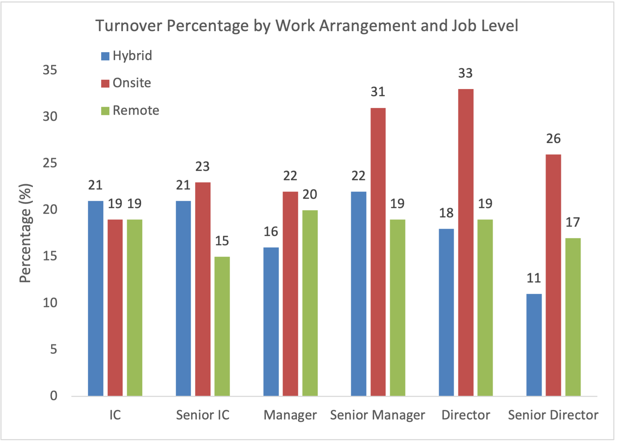
Data Exploration and Initial Insights
Employee experience variables and performance ratings lean to the positive end.
All employee experience variables are moderately to strongly correlated.
No statistically significant difference is found in demographic segmentations except for work arrangement.
Specific groups have higher turnover, including senior managers, directors, Operations and Sales, Asians, Latin Americas, and onsite employees.
Onsite workers have higher turnover; senior leaders (SM, D, SD) who work onsite have statistically significantly higher turnover.
No clear relationship exists between team size and turnover (r = -0.01); a few larger teams have higher turnover as outliers.

Slide 8
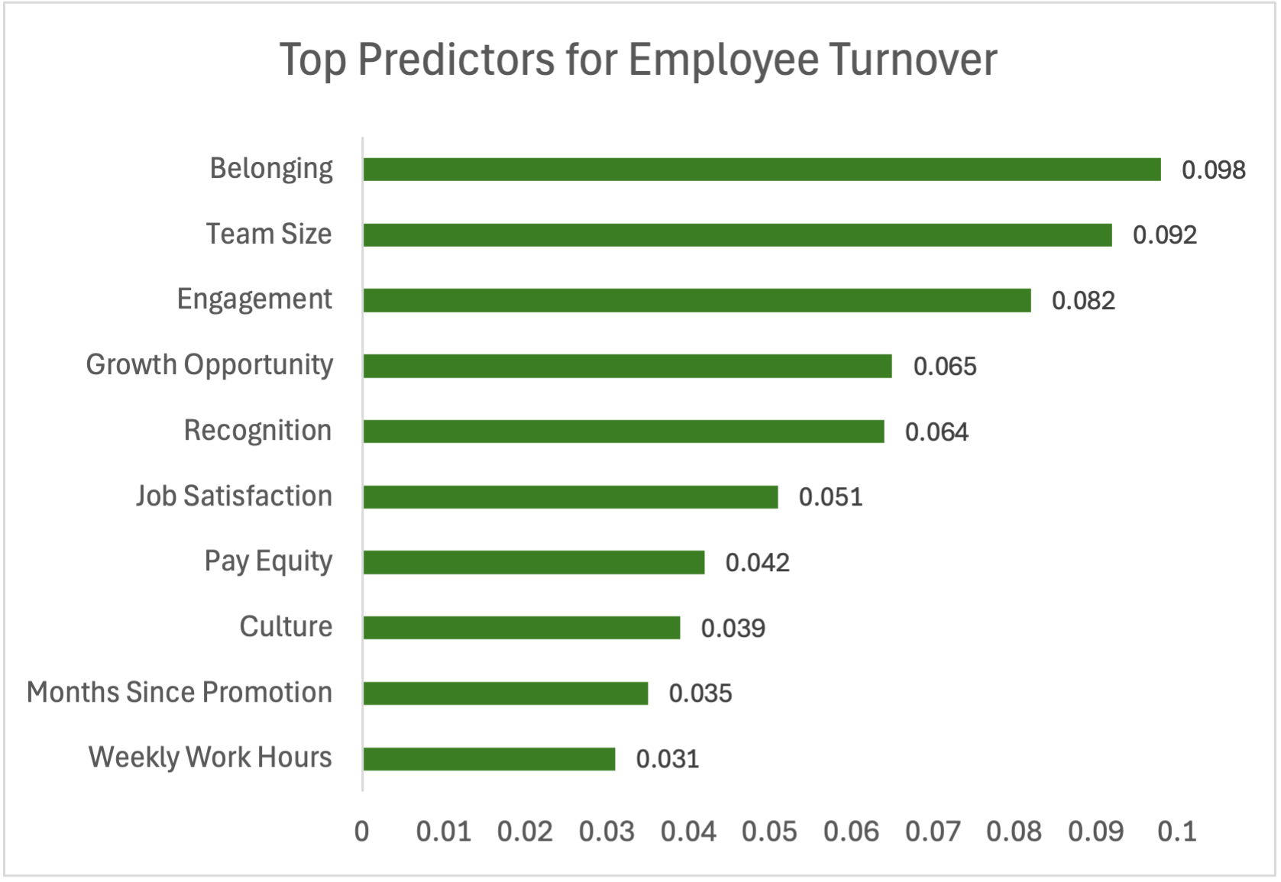
Key Insights on Reducing Employee Turnover
Employee Experience factors are more significant predictors than pay equity, demographics, and other variables.
Belonging: Lack of a sense of belonging significantly drives turnover (r = -0.38).
Team Size: Even though team size predicts turnover, it is not correlated with turnover (r = -0.01).
Engagement: Low engagement strongly indicates potential attrition (r = -0.37).
Growth Opportunity: Limited career growth leads to higher turnover risk (r = -0.39).
Recognition: Lack of recognition demotivates employees, leading to exits (r = -0.29).

Slide 9


Impact and Actionable Recommendations
Belonging
Engagement
Growth
Recognition
Higher belonging is 50% less likely to be at risk,
8x more likely to be high performers.
Higher engagement is 2x less likely to be at risk,
6x more likely to be high performers.
Higher growth is 25% less likely to be at risk,
4x more likely to be high performers.
Higher growth is 2x less likely to be at risk,
4x more likely to be high performers.
Organize regular, informal onsite/virtual networking events (e.g., games, coffee chats, lunch and learn)
Redesign onboarding by adding a 90-day onboarding journey with weekly check-ins and peer mentors
Provide sponsorship and a dedicated budget for ERGs
Encourage taking PTOs and launch wellbeing initiatives to encourage work-life balance
Align employees’ work and growth with company values and mission to create a sense of purpose
Assess current work arrangements to pinpoint groups and job levels for onsite work optimization.
Develop clear promotion criteria and career pathways
Offer ongoing training and skill-building workshops and evaluate results
Implement mentorship matching programs for both peer and top-down mentorship
Create a ‘gig work marketplace’ to offer stretch projects across teams
Implement a online recognition platform to provide shout-outs
Introduce 5-minute ‘kudos moments’ in meetings for frequent formal appreciation
Launch award initiatives to recognize stellar contributions
Offer personalized rewards to make recognition meaningful and tangible

Slide 10
Measuring Impact and Next Steps
Action planning based on effort vs. impact, and strategic alignments with business goals and company values
Success Metrics & Expected Outcomes
Short Term Quick Wins (0-3 months)
Organize informal networking events
Introduce 'Kudos Moments' in meetings
Encourage PTOs & wellbeing initiatives
Create 'Buddy Systems’ for new hire
Support ERGs with budget & sponsors
Workforce:
20% increase in Employee engagement (e.g., job satisfaction, eNPS)
20% decrease in turnover intention
10% YOY decrease in turnover
Customer:
20% increase in customer satisfaction (NPS)
Business:
10% reduction in recruitment costs
10% YOY increase in profits
Mid Term (3-6 months)
Create a 90-day onboarding journey
Use advanced analytics to pinpoint employees to work onsite
Set up mentorship matching programs
Offer ongoing training workshops
Evaluation Methods
Long-term Big Bets (6-12 months)
Implement Gig Work Marketplace
Implement a recognition platform
Maintain and refine the predictive model to identify at-risk employees in real-time.
Quantify success of each initiative
Monitor effects on the at-risk groups
Use quarterly surveys to track EX over time
Create dashboards to track real-time turnover
Partner with HR, Sales, and Finance to obtain hiring, customer, and financial data and assess change

